Slide 2
Object Literals and the Brackets Notation
One can use both dot notation and brackets notation
var car = {}; car.color = "red";car["color"] = "green";
Note that using the brackets notation, I essentially just wrap each property's key as a string,

Slide 3
Arrays are Objects
One of the most commonly used built-in methods on arrays are the push() and the pop() methods fruits.push("apple"); // ['apple']
I can now call the arrayBuilder() function, arrayBuilder('apple', 'pear', 'plum'); // ['apple', 'pear', 'plum’]
Additionally, I can save this function call to a variable. var simpleArr = arrayBuilder('apple', 'pear', 'plum');

Slide 4
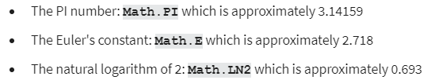
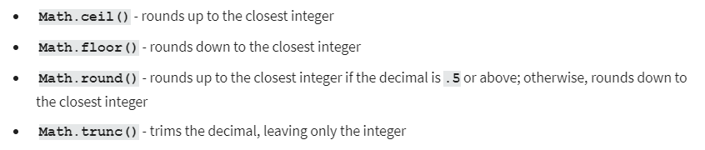
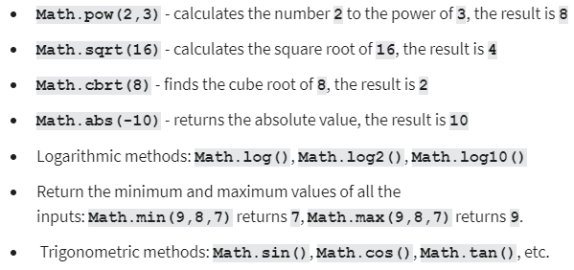
Math object cheat sheet

Slide 5
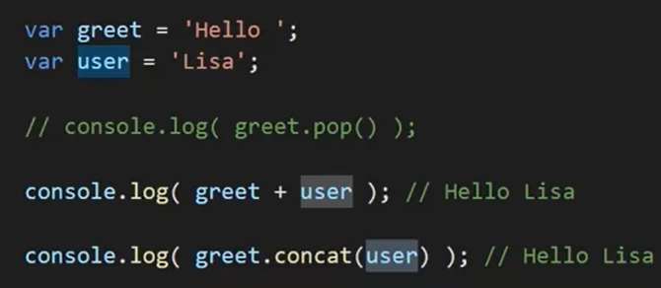
String concatenation

Slide 6
String cheat sheet
var greet = "Hello, ";
var place = "World"
greet.length;
greet.charAt(0); // 'H’
"Wo".concat("rl").concat("d"); // 'World’
"ho-ho-ho".indexOf('h'); // 0
"ho-ho-ho".split("-"); // ['ho', 'ho', 'ho']
greet.toUpperCase(); // "HELLO, "

Slide 7
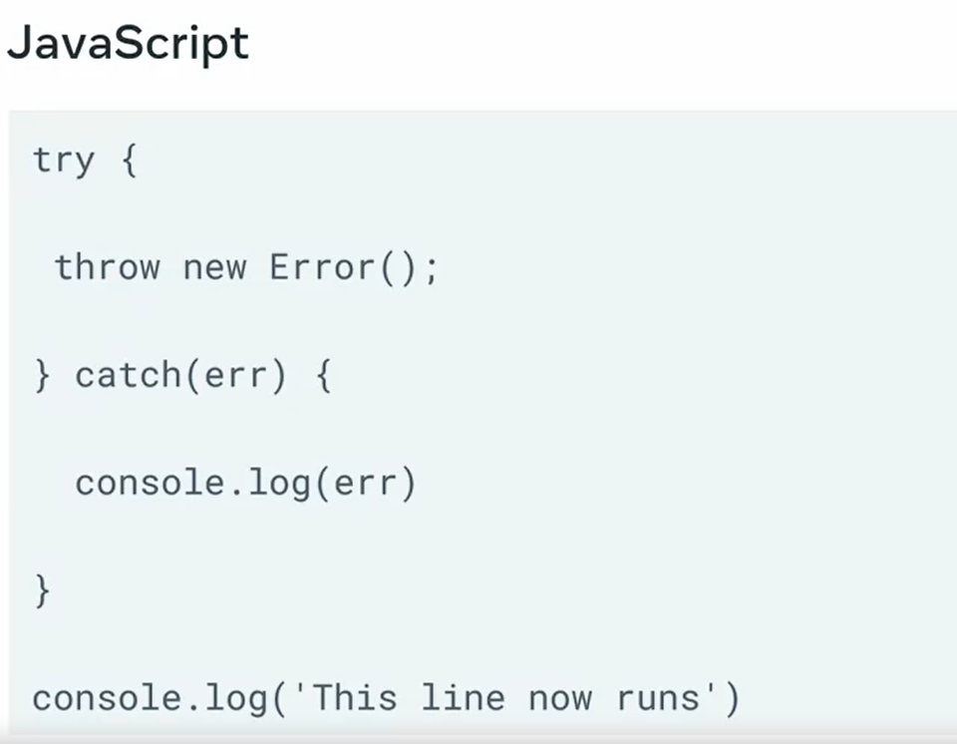
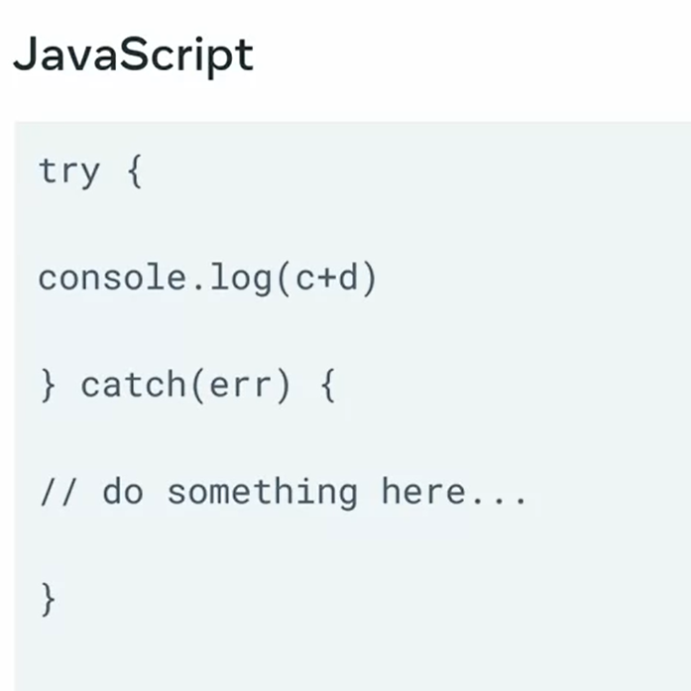
Error handling
Code in try after throw new error will not be executed; it will go to catch instead

Slide 8
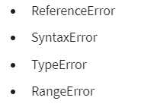
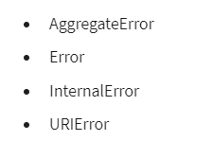

Slide 9
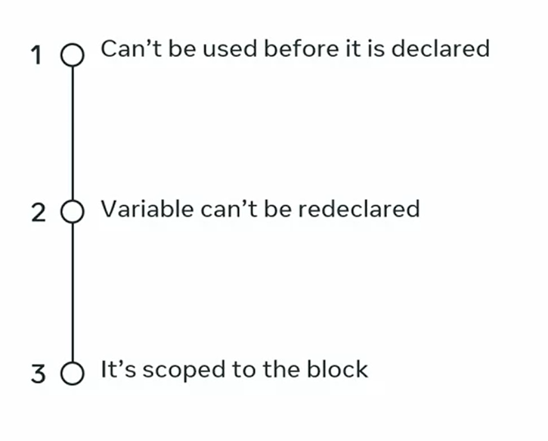
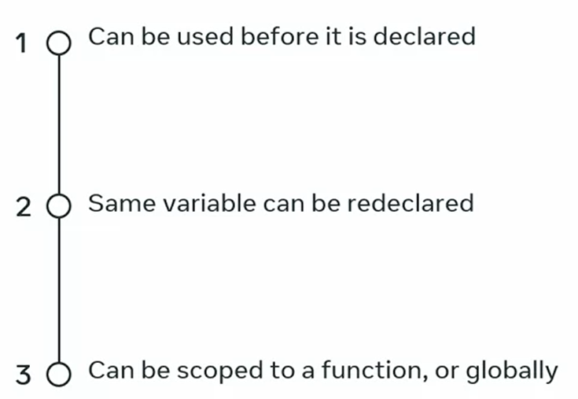
Var let const

Slide 10
OOP
Inheritance
Encapsulation
Abstraction
polymorphism

Slide 11

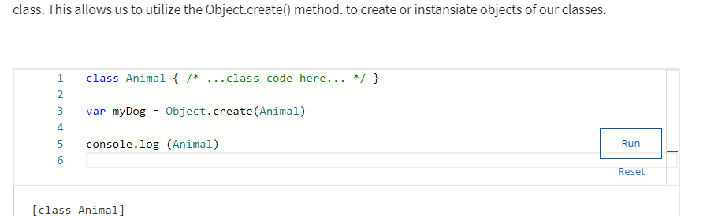
Object.create(className)
Create new object of a class
more common method of creating obbjects from classes is to use the new keyword.

Slide 12

Inheritance
To setup the inheritance relation between classes in JavaScript, I can use the extends keyword, as in class B extends A.

Slide 13
Encapsulation
In the simplest terms, encapsulation has to do with making a code implementation "hidden" from other users, in the sense that they don't have to know how my code works in order to "consume" the code.
I don't really need to worry or even waste time thinking about how the toUpperCase() method works. All I want is to use it, since I know it's available to me.

Slide 14
Abstraction
Abstraction is all about writing code in a way that will make it more generalized.
An abstraction is about extracting the concept of what you're trying to do, rather than dealing with a specific manifestation of that concept.
Encapsulation is about you not having access to, or not being concerned with, how some implementation works internally.

Slide 15
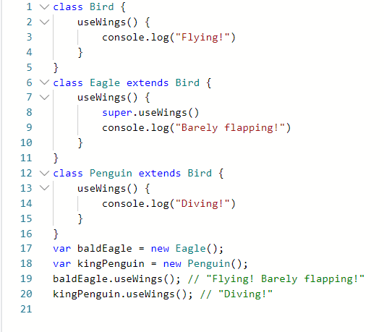
Polymorphism
Polymorphism is a word derived from the Greek language meaning "multiple forms". An alternative translation might be: "something that can take on many shapes".
The Penguin and Eagle sub-classes both inherit from the Bird super-class. The Eagle sub-class inherits the useWings() method from the Bird class, but extends it with an additional console log. The Penguin sub-class doesn't inherit the useWings() class - instead, it has its own implementation, although the Penguin class itself does extend the Bird class.

Slide 16
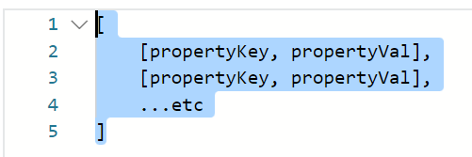
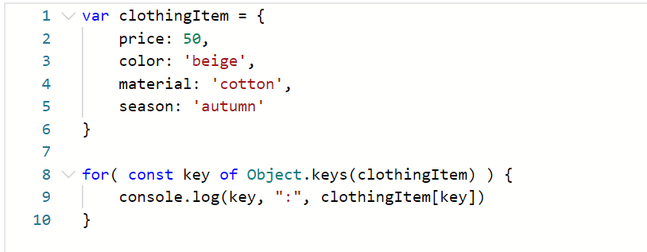
Loop an object
Object.entries()

Slide 17
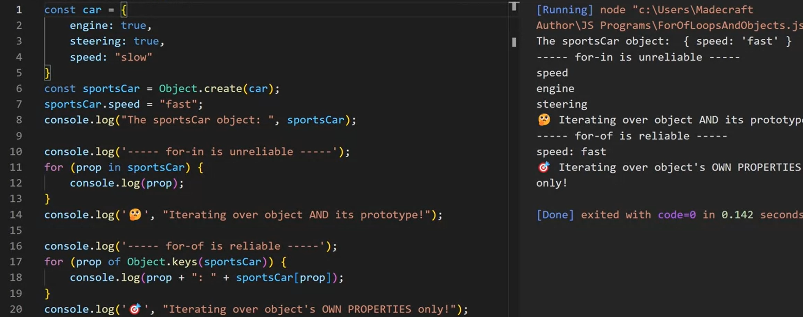
For-of vs for-in
For-of: only the object properties
For-in: object and its prototype

Slide 18
Template literals
console.log(`${greet} ${place} !`)//placeholder by ${}
template strings can span multiple lines.
//it's possible to perform arithmetic operation inside a template literal expression console.log(`${1 + 1 + 1 + 1 + 1} stars!`)

